Slide 1
Smart Password Generator
https://github.com/samcodes08/ALGO

Slide 2
Problem:
“The weakest link for security is human, who chooses weak password and does not follow proper password policy”
Eg : abc123 , qwerty , Name123 , 1997bml .
This is the biggest possibility of threat(threat) and this could be biggest loss for the company.

Slide 3



Target Audience
1.Corporate office employees.
2.University students

Slide 4
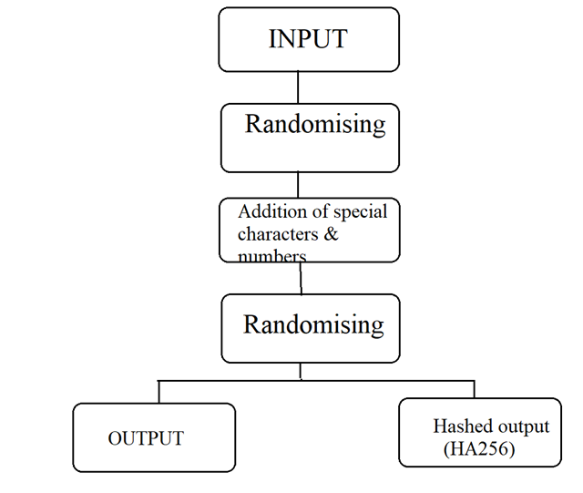
METHODOLOGY

Slide 5
Algorithm:
1.Ask user 3 unique questions from question set randomly.
2.The system assigns a minimum of 1 to maximum of 3
numbers ranging from 0-9 and symbols.
3.By taking answers from question as input ,system will randomly pick up answers and arrange them by considering step 2.
4.Additionally the password is also hashed using SHA 256.
(Complexity :O(n))

Slide 6
Test Cases
1.Use capital letters while giving input.
2.Using same answers for all the next round.
3.Checking for pattern.

Slide 7
Cracking the password using Brute force method
let the first answer be A1.
let the first answer be A2.
let the first answer be A3.
Since there are 10 numbers(0 to 9) there are 10 probable chances.
Since there are 8 symbols there are 8 probable chances.
Since there 52 letters including small letters and capital letters since our system is not case sensitive.There are 52 probable chances since each letters is considered unique and repetitions are allowed.
By doing permutations:
A1 A2 A3 N1 N2 P1
(52)^{A1} x (52)^{A2} x (52)^{A3} x 10 x 10 x 8

Slide 8
Current Research work
There is currently no research work going on generating on human memorable passwords(easy to remember+strong) but there are many online web portals providing random password generator.

Slide 9
Limitations
The only limitation is that the user has to remember the generated password.
To remember the special characters in the password.

Slide 10
Future Scope
The questionnaire asked can be system generated instead by bot using Artificial Intelligence and integrating natural language processing module would help to diversify the project by adding perspective and hence can be used globally.

